Slide 1


IMDb Reviews Analysis
Make the most from user reviews
Nir Shelly & Shani Noy
October 2020

Slide 2
Main things we did and challenges
Analyzing the text:
Test if there are NA
Test if data is balanced
Explore our text: are there special characters (as <br \>), length of text
Which tokenizer to use (word_tokenize / RegexpTokenizer from nltk)

Slide 3
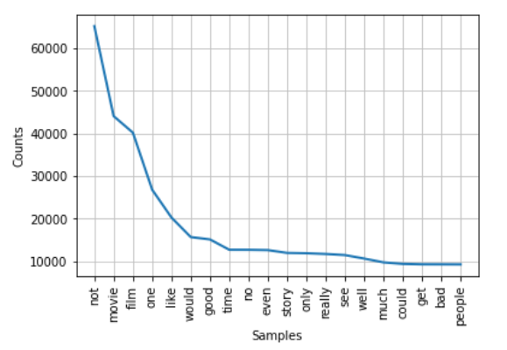
Main things we did and challenges
Analyzing the text:
Which words are most used (after we preprcossed the text)

Slide 4
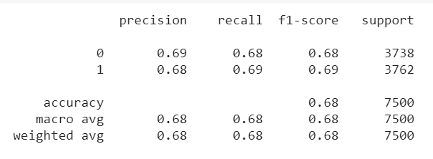
Main things we did and challenges
Preprocessing the text
Creating a function to preprocess (see clean_reviews function)
Classification of reviews (supervised model)
Running Doc2Vec and using DecisionTreeClassifier

Slide 5
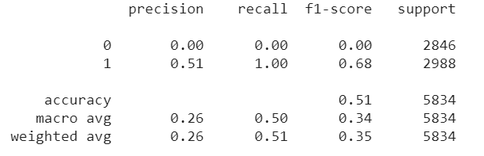
Main things we did and challenges
Classification of reviews (supervised model)
Running Word2Vec and using DecisionTreeClassifier

